Slide 1

DF
Reference Slides (Hashing)
Diploma in ISF/IT
Year 2/3 (2017/18), Semester 4/6
Digital Forensics
Notes:
Left-hand Bar – Replace FSP by your module code and X by the lecture number.
Replace Lecture Title
Replace < Module Name >
Replace Year and Semester if necessary

Slide 2
Evidence Preservation – Hashing
In authentication, hashing is used to create a set of numbers that represent a drive or set of files. This is similar to fingerprinting someone.
With hashing, a finger print is created from the evidence. No details about the evidence can be determined from the hash value, but if the evidence is altered in any way, the hash value will also change.

Slide 3
Evidence Preservation – Hashing (cont.)
Two examples of hash functions are MD5 and SHA-1.
MD5 was developed by Professor Ronald L. Rivest of MIT. It takes as input a message of arbitrary length and produces a 128-bit(16bytes) hash value.
Secure Hash Algorithm (SHA) is a set of cryptographic hash functions designed by the National Security Agency (NSA). It takes a message shorter than or equal to (2⁶⁴ -1) bits in length and produces a 160-bit(20bytes) hash value.

Slide 4
Evidence Preservation – Hashing (cont.)
The md5sum tool produces an md5 message digest (hash value). The hashcalc application can also create hash values using different hashing methods.
The hashing is done on the data itself, and not on the names of files. There are existing databases of hash values for images, that can be used to find child pornography.
Hashing
Enforces Integrity
Ensures data not modified

Slide 5
Creating a Hash Value
Hash Value of the message can be computed based on a hash function.
A Hash Function is a mathematical function that able to scramble the given data into unreadable form.
Original Message
HASH FUNCTION
Hash Value

Slide 6
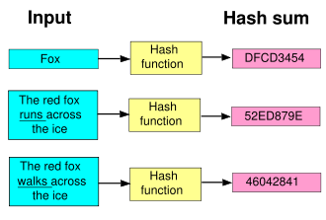
Creating a Hash Value/Sum – cont.

Slide 7
Properties of Hashing
Fast and efficient one-way function that generate a bit sequence of fixed length from the original message. i.e. creating the hash value is fast. The size of hash value is small.
Process is proven to be irreversible (nearly impossible within a useful amount of time). → Original message cannot be recovered from the hash value.

